Slide 1
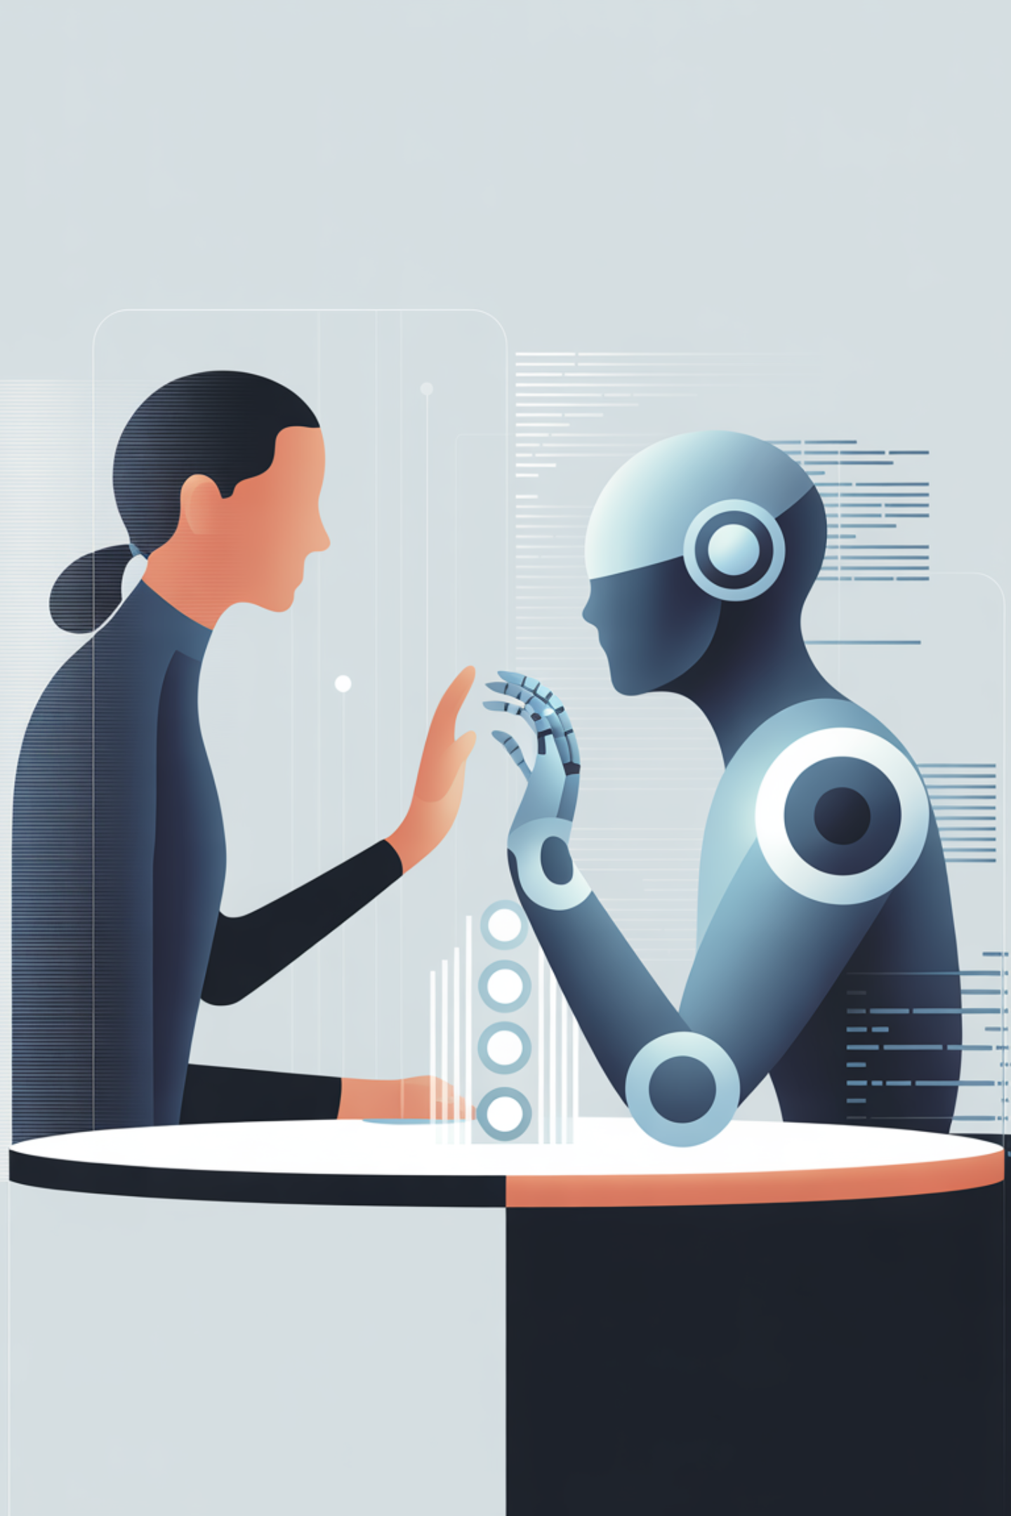
Appropriate Reliance on AI
From Research to Implementation
Fabio Correa | Microsoft Corporation | February 2026

Slide 2
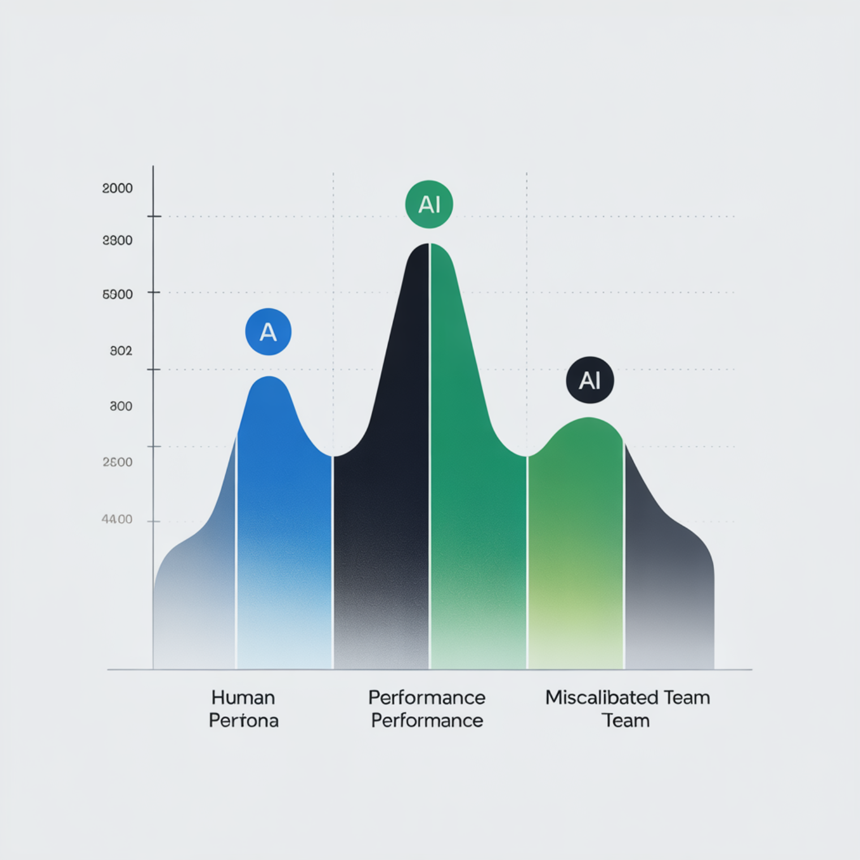
THE PROBLEM
Human+AI Teams Often Perform Worse Than Either Alone
Dell'Acqua et al. (2023) discovered a surprising finding: when trust is miscalibrated, collaboration backfires. AI makes confident mistakes, humans accept without verification, and combined performance drops below baseline.
The culprit isn't AI capability—it's miscalibrated confidence. Understanding this dynamic is the first step toward building better human-AI systems.

Slide 3
Two Sides of the Same Coin
Hallucination + Over-reliance = Compounded Risk
Hallucination
Over-reliance
What happens: AI generates plausible but wrong information
What happens: Users accept without checking
Result: Errors propagate uncaught
Result: Bad data enters decisions
Both stem from the same root: AI expresses certainty regardless of actual reliability. When these forces combine, they create compounded risk that undermines the entire collaboration.

Slide 4
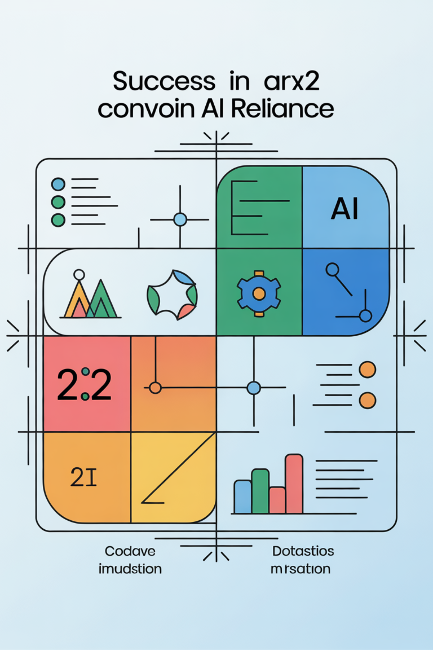
What Is Appropriate Reliance?
A Precise Definition: Users accept correct AI outputs AND reject incorrect ones
CAIR
CSR
Correct AI-Reliance: Trust AI when it's right
Correct Self-Reliance: Trust yourself when AI is wrong
Two measurable components from Schemmer et al. (2023). Goal: Maximize both simultaneously. AoR = 1 is optimal performance.

Slide 5

KEY INSIGHT
The Reframe That Changes Everything
Traditional View
New Insight
"Build trust in AI"
"Build calibration of trust"
Focuses on attitude
Asks "Do you trust AI?"
Can be too high or too low
Static mindset
Focuses on metacognitive skill
Asks "Can you tell when trust is warranted?"
Measures accuracy of judgment
Learnable capability
It's not how much you trust—it's how well you calibrate. This distinction transforms how we design AI systems and measure their success.

Slide 6
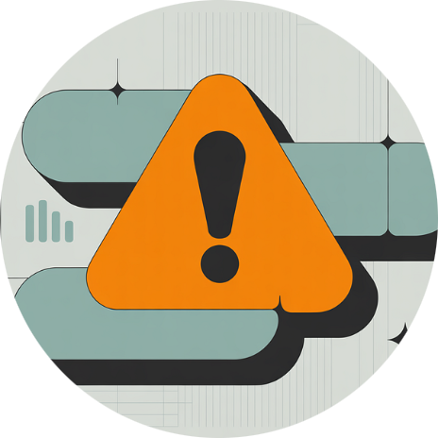



The Trust-Calibration Matrix
Four User Profiles
⚠️ Dangerous
✅ Optimal
❌ Wasteful
✅ Selective
High Trust, Low Calibration
High Trust, High Calibration
Low Trust, Low Calibration
Low Trust, High Calibration
Over-relies on AI, consistently misses errors. The most dangerous profile.
Misses AI value, underutilizes capabilities.
Appropriately skeptical, cautious but effective.
Trusts appropriately, maximizes value from collaboration.

Slide 7



EVIDENCE-BASED
What Research Says Works
Three Proven Interventions
AI Self-Critiques
Contrastive Explanations
Low-Confidence Expressions
+50% error detection
+20% accuracy on AI errors
Saunders et al., 2022
Si et al., 2023
-25% false user confidence
Steyvers et al., 2024
These aren't hypothetical—they're measured outcomes from controlled studies. Each intervention addresses miscalibration through different mechanisms, and they can be combined for greater effect.

Slide 8
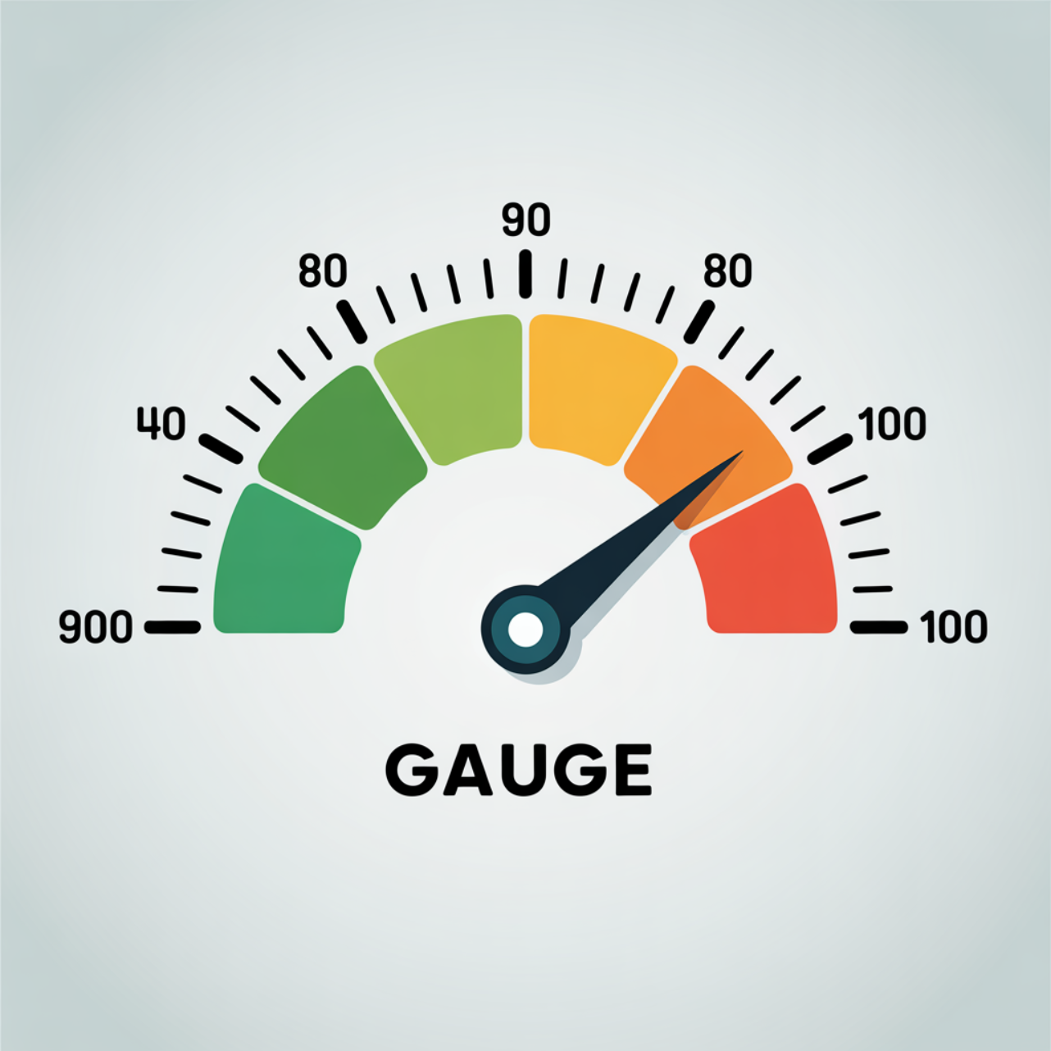
Implementation: Confidence Ceiling
Never Claim What You Can't Support
Based on Lin et al. (2022): Models can verbalize calibrated uncertainty. The 90% ceiling communicates "This should work, but verify."
Content Type
Max Confidence
Direct file reading
100%
Documented patterns
90%
Factual without source
70%
Inference / edge cases
50%

Slide 9
Implementation: Mode Separation
Epistemic vs. Generative—Different Rules for Different Outputs
Epistemic Mode
Generative Mode
Factual claims about reality
Source grounding required
Confidence ceilings apply
"According to the docs..."
Creative ideas and proposals
Collaborative framing
Exploration encouraged
"Here's an idea to explore..."
When accuracy matters most
When imagination leads the way
Key insight: Applying epistemic constraints to creativity impoverishes collaboration. Not all AI output needs the same calibration approach.

Slide 10
Implementation: Human Judgment Flags
Some Decisions Require Human Authority
AI informs but doesn't decide on matters involving human values, accountability, and nuanced trade-offs:
Business Strategy
Ethical Dilemmas
Personnel Decisions
Priorities and direction
Values and principles
Hiring and performance
Security Architecture
Legal Compliance
Risk and access
Regulatory obligations
Pattern: "I can outline the options, but the choice depends on your priorities around [tradeoff]."

Slide 11
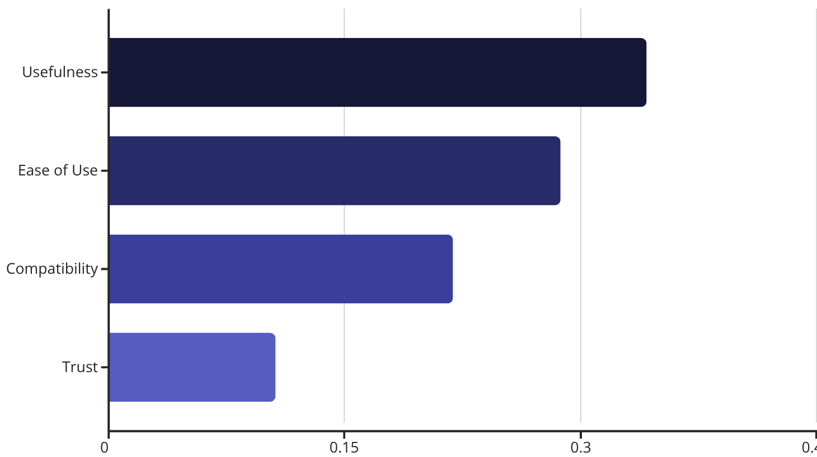
RESEARCH FINDING
The AIRS-16 Discovery
Trust Was Only Marginally Significant
From validation study (N=523) examining 8 constructs predicting AI adoption:
Trust in AI (TR): β=.106, p=.064—barely significant
Provocative question: What if trust level doesn't predict adoption, but trust calibration does?
This discovery led to proposing Appropriate Reliance as a new construct, measured through AIRS-18.

Slide 12
Proposed AIRS-18 Extension
Two New Items to Measure Calibration
1
2
AR1: Reliability Detection
AR2: Judgment Discrimination
"I can tell when AI-generated information is reliable and when it needs verification."
"I know when to trust AI tools and when to rely on my own judgment instead."
Three Key Hypotheses:
AR shows discriminant validity from TR (trust is not calibration)
AR provides incremental predictive power for adoption
AR moderates the trust → adoption relationship
These items measure metacognitive awareness rather than mere confidence or attitude.

Slide 13
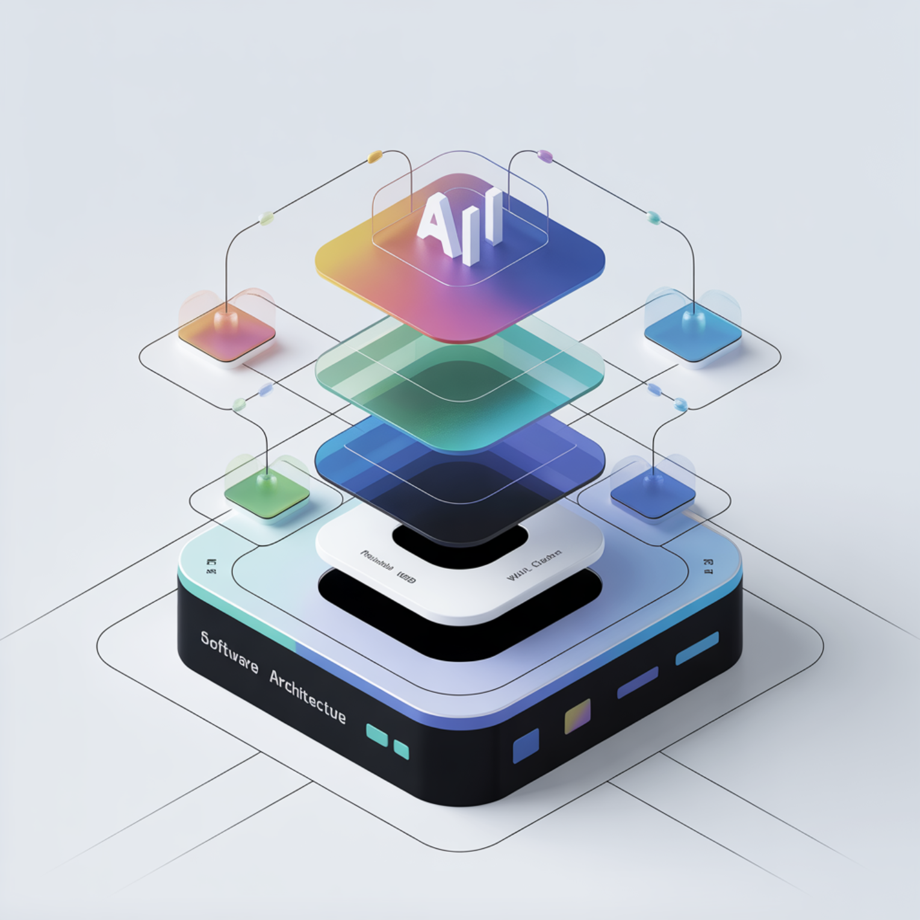
LIVE IMPLEMENTATION
Alex Cognitive Architecture
A Testbed for Appropriate Reliance Mechanisms
Currently deployed and collecting data across multiple platforms:
VS Code extension for developers
M365 Copilot agent for knowledge workers
~7,000 lines of AR-specific protocol code
CAIR/CSR framework embedded in responses
Multi-platform comparison opportunity
This living implementation allows us to test theoretical constructs in real-world contexts and gather empirical evidence.

Slide 14
KEY TAKEAWAYS
What to Remember
Miscalibration Destroys Value
1
Human+AI can perform worse than either alone when trust is miscalibrated
2
Build Calibration, Not Just Trust
The skill to discern when trust is warranted matters more than trust level
Three Interventions Work
3
Self-critiques, contrastive explanations, and uncertainty expressions have proven effects
4
Mode Matters
Epistemic claims need different treatment than creative contributions
Measurement Is Possible
5
CAIR/CSR framework provides concrete, actionable metrics

Slide 15

The Path Forward
From Individual Trust to Collective Intelligence
"AI can bridge gaps of time, distance, and scale, but only if built correctly. We must design AI to support shared goals, group context, and the norms of collaboration."
— Jaime Teevan, Microsoft Chief Scientist
The frontier ahead is clear: teams, organizations, and communities getting better together with AI. By focusing on appropriate reliance rather than blind trust, we unlock the true potential of human-AI collaboration at every scale.

